Slide 1
A Deep Learning Approach to Diagnostic Class classification of Prostate Cancer Using Pathology–Radiology Fusion
Sara Khosravi
October 2021

Slide 2
Overview
Published in 2021 , cited 2 times
Written by :
Pegah Khosravi : Deep learning specialist working in Memorial Sloan Kettering Cancer (NY Hospital)
Ehsan Kazemi: google machine learning staff (previously Sharif EE student)
Alexandros Sigaras and Pantelis Zisimopoulos: working in Cornell Medicine faculty
Chicago students and …
Code available on: https://github.com/ih-lab/ai-biopsy

Slide 3
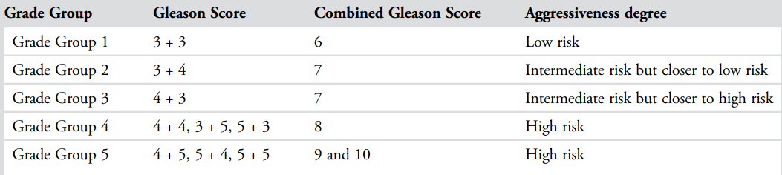
Review
Gleason Score (GS):
most common prostate cancer detection score, based on biopsy
sum of primary and secondary scores, each with a range of 3 to 5
Grade Group (GG): alternative scoring system, divides prostate cancer into five categories
Fig1. Combined dataset (combination 0f 5 public datasets)

Slide 4
Background
PI-RADS: standardized guideline in Prostate Imaging Reporting and Data Systems for interpretation and reporting MRIs
Designed to improve and standardize detection, localization and characterization
Radiologists apply PI-RADS to :
extract features such as lesion shape and margins for categorization of prostate cancer
assess with a score ranging from 1 to 5
Effective but requires expert’s visual assessment

Slide 5
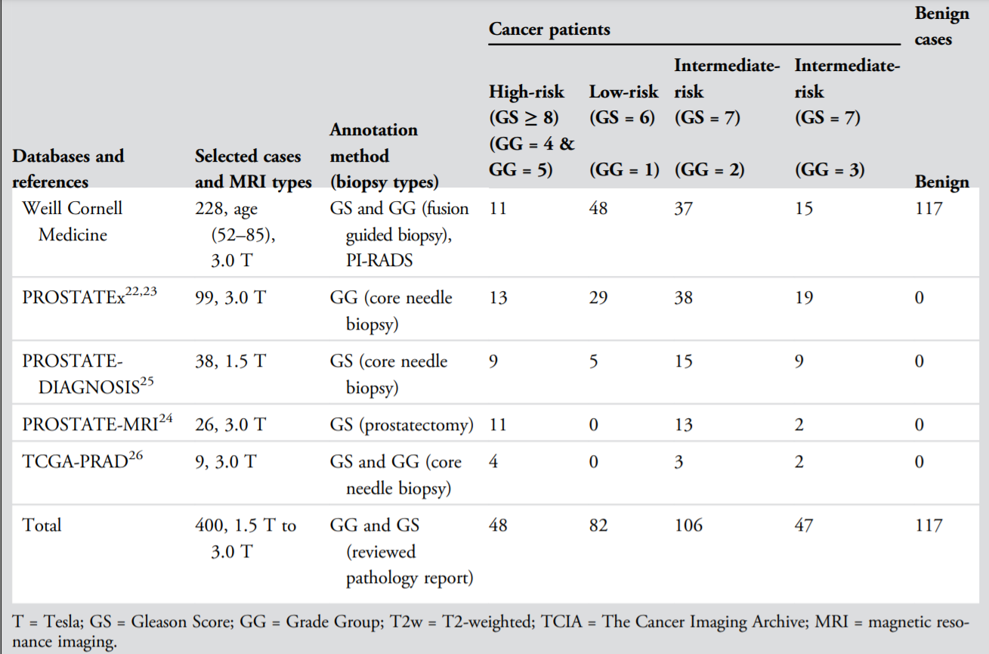
Dataset
2 kinds of datasets:
from 400 patients in general
228 patients from their hospital (in-house dataset)(private)
172 patients from other public datasets (publicly available)
Fig2. Combined dataset (combination 0f 5 public datasets)

Slide 6
Methods
6

Slide 7
Methods
Use multi-model classification to reach better results
develop a CNN-based method that :
recognizes benign from cancerous tumor
recognizes high-risk prostate cancer from low-risk forms
Image specs: T2w slices, thickness 3 mm, no gap, in-plane dimension: ≤0.7 mm

Slide 8
Methods
All public and in-house data were converted from DICOM to PNG format and regularized for intensity inhomogeneity using a Python script. (histogram equalization techniques)
For each patient, consistent sequences of seven axial image slices containing the prostate gland (=2800 images interpolated to 512 × 512 pixels) were reviewed and selected by two radiologists.
For in-house data, the assigned PI-RADS1-5 scores were reviewed by these two radiologists

Slide 9
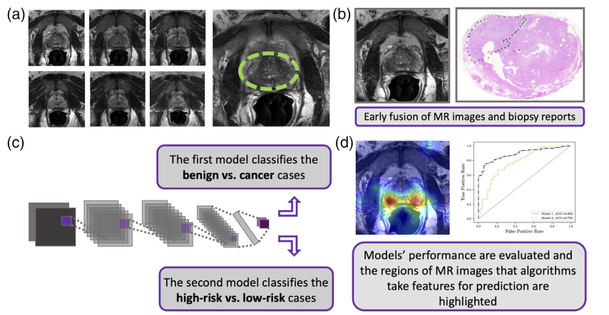
Methods
Each patient MRI consists of seven axial T2w slices (representing prostate gland)
Each patient’s MRI slice labeled by their corresponding biopsy result based on its GG and GS
A CNN-based model classifies the cancer vs. benign and high-risk vs. low-risk
Fig3. Method overview

Slide 10
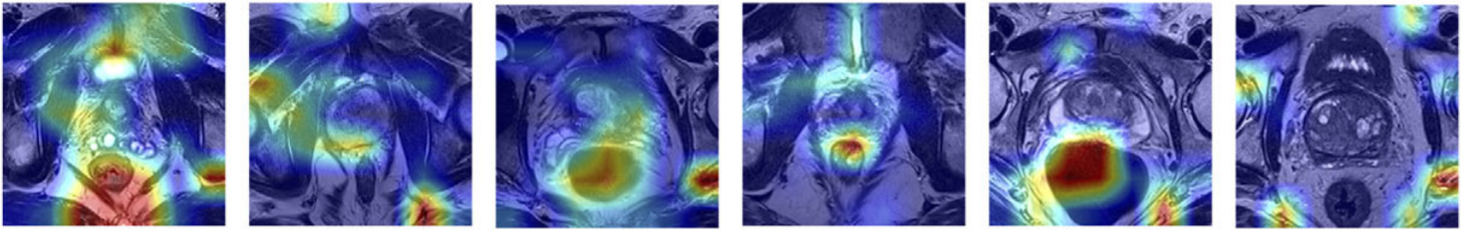
Methods
Fig4. Different features based on their importance

Slide 11
Methods
Used Google’s Inception-V128 (GoogleNet) as the main architecture
Used transfer learning to train this architecture and pretrained the network on the ImageNet
Effective run-time and computational cost

Slide 12
First Model: Malignant vs. Benign
Train phase: group GG = 3, 4, and 5 together in one class (n = 95 patients)
Did not use GG = 1, 2 patients for training, so as to allow the algorithm to learn the two ends of the spectrum and take more associated features for classifying cancer vs. benign.
Test phase : on all GGs

Slide 13
Second Model: High-risk vs. Low-risk
Train phase: Grouped GG = 3, 4, 5 together in one class as high-risk (n = 95 patients) and trained the algorithm vs. the low-risk class that combined GG = 1 and 2 (n = 188).
Used oversampling techniques: adding Gaussian noise to the images, to address the class imbalance problem. Noise injection consists of injecting a matrix of random values usually drawn from a Gaussian distribution.
Test phase : on all GGs

Slide 14
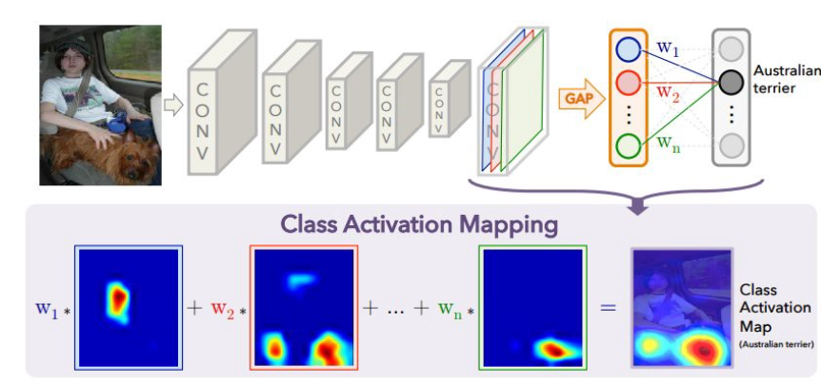
Second Model: High-risk vs. Low-risk
Applied class activation map (CAM): Identify the importance of the image regions by projecting back the weights of the output layer onto the convolutional feature maps.
using global average pooling (GAP) in CNNs, performed on the convolutional feature maps and used those as features for a fully connected layer.
Fig5. CAM

Slide 15
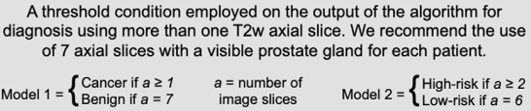
Methods

Slide 16
Evaluation

Slide 17
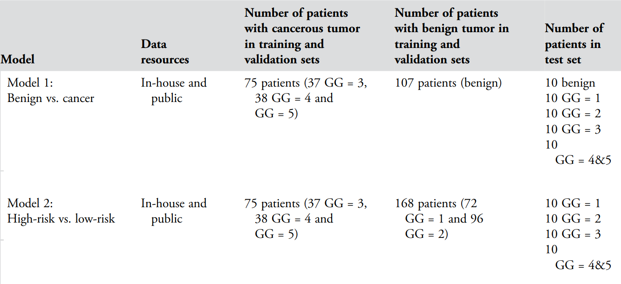
Results
Fig4. Characteristics of Both Trained Models and the Comprised Patients

Slide 18
Results
Metric: AUC, ROC
Model 1 was able to distinguish cancer patients from benign patients with an AUC of 0.89
Model 2 was able to classify high-risk vs. low-risk (GS = 5 + 5, 5 + 4, 4 + 5, 4 + 4, 4
+ 3 vs. GS = 3 + 3, 3 + 4) cancer with an AUC of 0.78
While the performance of Model 2 in classifying GS ≥ 8 vs. GS =6 was high (AUC = 0.86), the ability of Model 2 to classify intermediate-risk cases (GS = 3 + 4 vs. GS = 4 + 3) of prostate cancer was lower (AUC = 0.71).

Slide 19
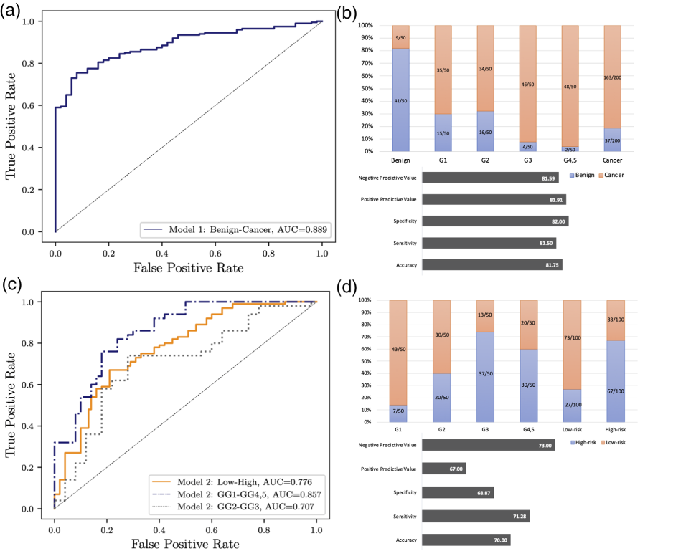
Results
Fig6. Results

Slide 20
Results: Compare with PI_RADS
Our model correctly identiﬁed 75% of the labels for high-risk vs. low-risk
PI-RADS predicted 53.6% of the patients correctly.
Cohen’s kappa values for AI-biopsy and PI-RADS in comparison to pathology results as a reference standard were 0.467 (moderate) and 0.195 (slight).

Slide 21
Results
AI-biopsy algorithm is able to detect the prostate gland when it predicts the pathology label correctly. When the AI biopsy prediction is incorrect, the algorithm does not detect the prostate gland.

Slide 22
Results
There are two main levels of data integration: early fusion (data are integrated before feeding to the model) and late fusing (different trained model will be integrated using various ML techniques). We used the early fusion technique and proposed CNN-based system, AI-biopsy, to fully utilize MR images and biopsy results to detect prostate cancer.

Slide 23
Advantages
The advantage of our method is that instead of only focusing on predetermined, segmented features to analyze, the unsegmented image of the prostate (without bounding box) is assessed, allowing for quantiﬁcation of all the available data.
Our study used a large heterogeneous data set and used all GGs for test.
It does not require any manual segmentation for testing new images and can be implemented in clinical practice by providing a straightforward platform to use without requiring sophisticated computational knowledge

Slide 24
Challenges
Different datasets, different prospects
To address the heterogeneity among cases as well as lack of details about the clinical infomation of all cases, we evaluated the algorithms through 5-fold cross-validation.

Slide 25
Thanks For Your Attention
Any Questions?
Contact: srkhsrv21@gmail.com

